Slide 1
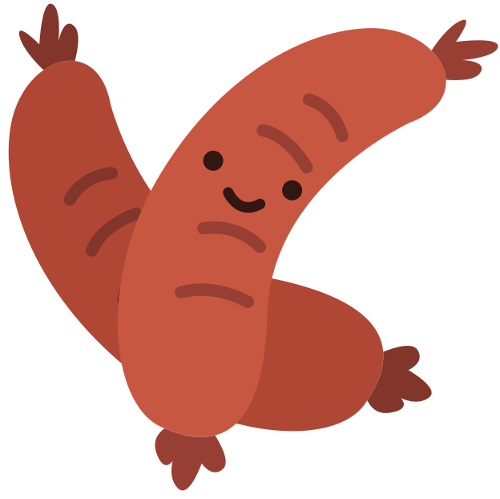

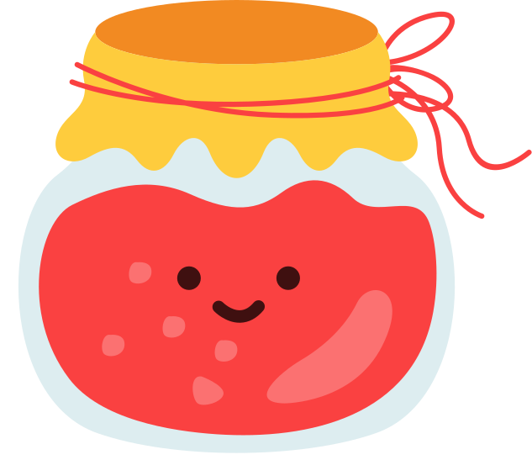
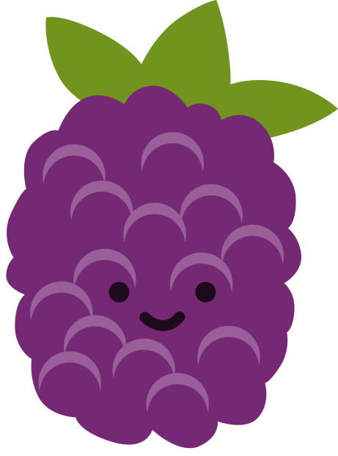
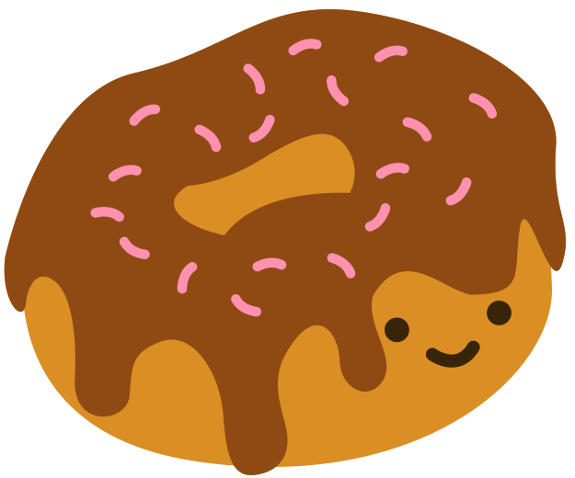
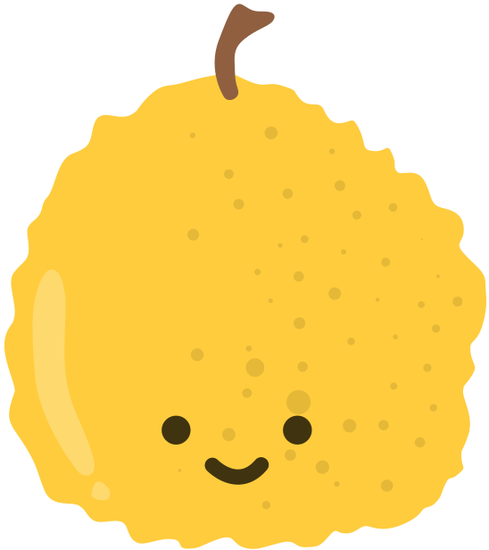
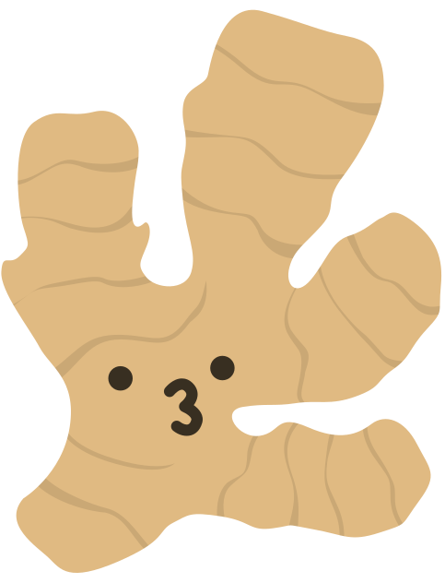
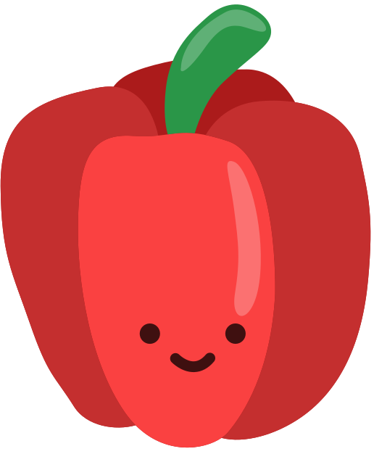
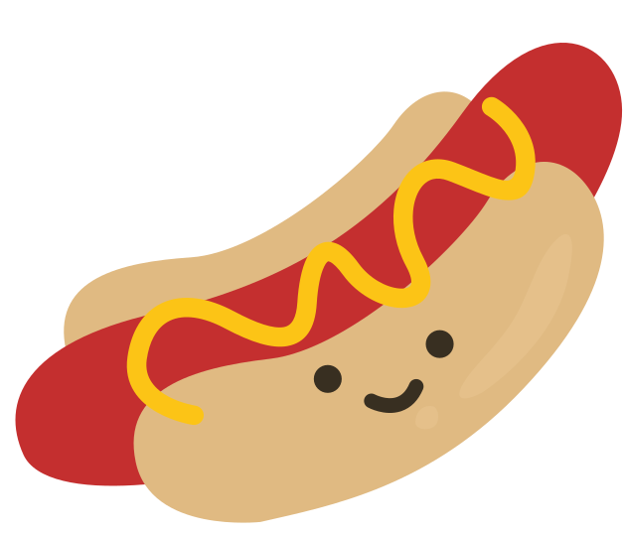
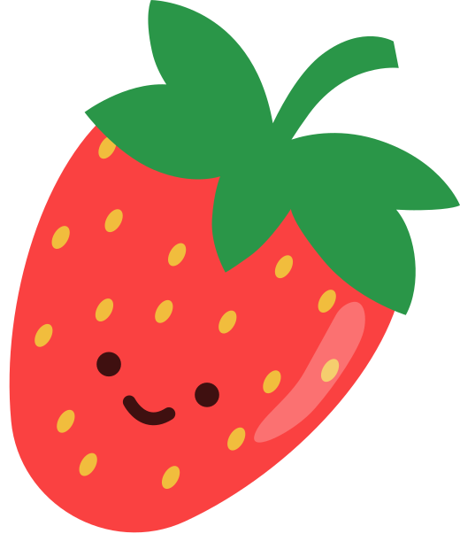

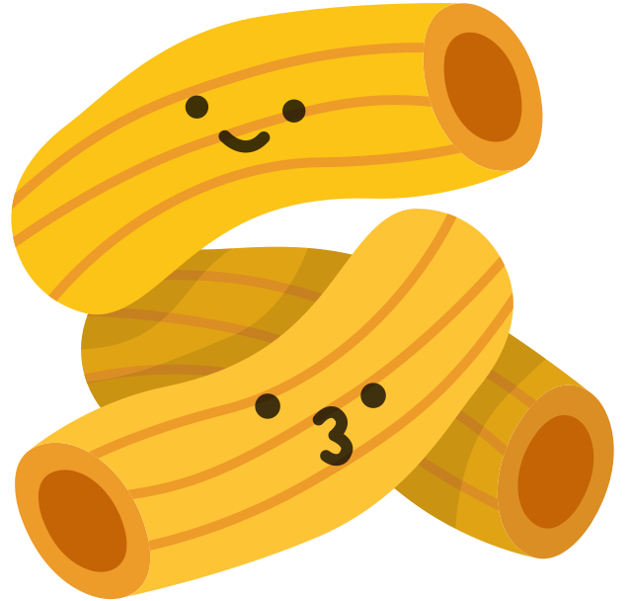

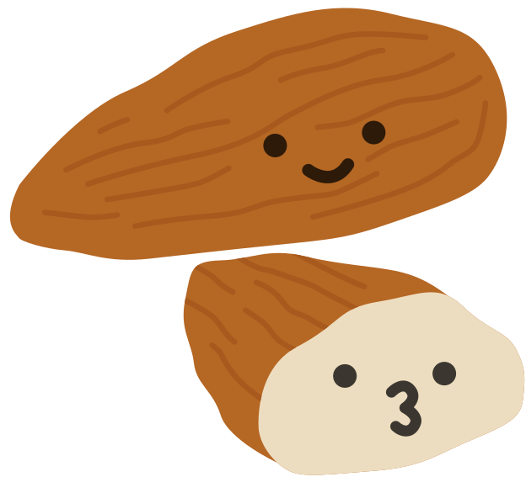

likes and dislikes
Let’s talk about food!

Slide 2
educative objectives
1
2
Students will be able to express their food preferences using “I like” and “I don’t like” with simple vocabulary.
Students will be able to recognize common food vocabulary through images and words.

Slide 3
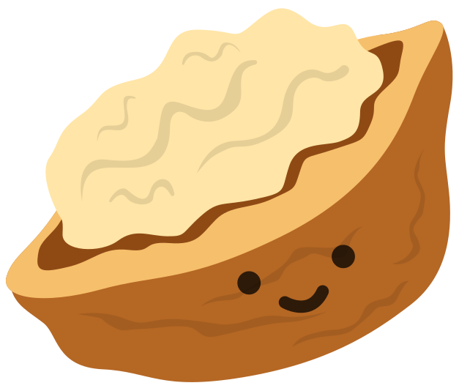

Everyone is different
We like different things
We all like different food.
Some people like pizza.
Some people like vegetables.
That’s okay!
We all have different likes and dislikes.

Slide 4
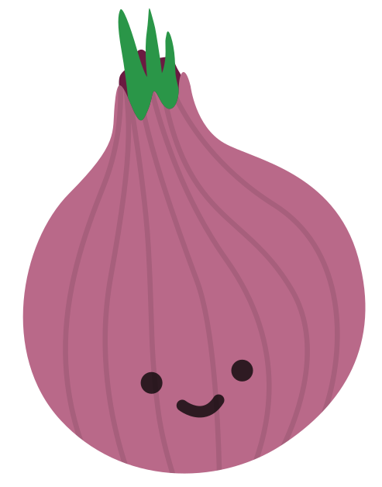
how do we say it?
When we like something we say “I like...”
Example: I like strawberries!
When we don’t like something we say “I don’t like...”
Example: I don’t like onions.

Slide 5
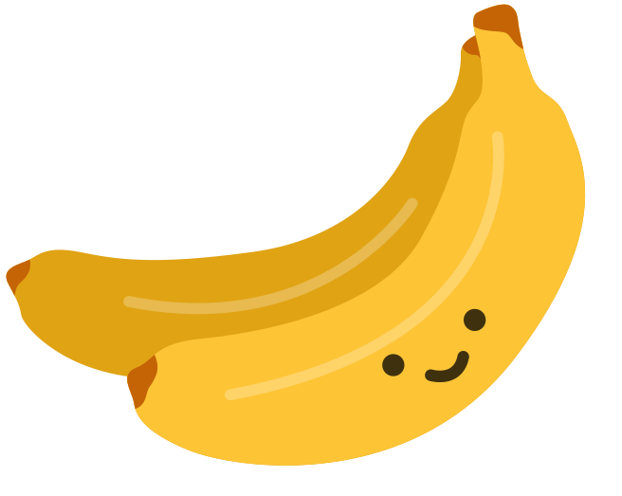
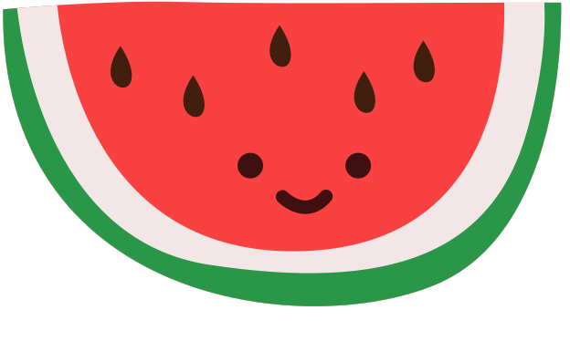

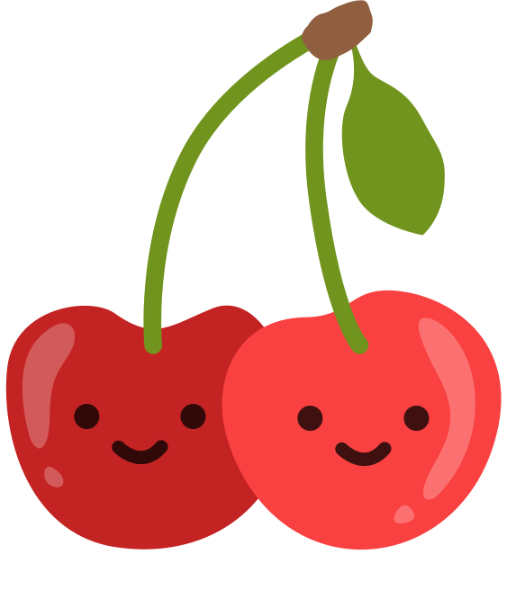
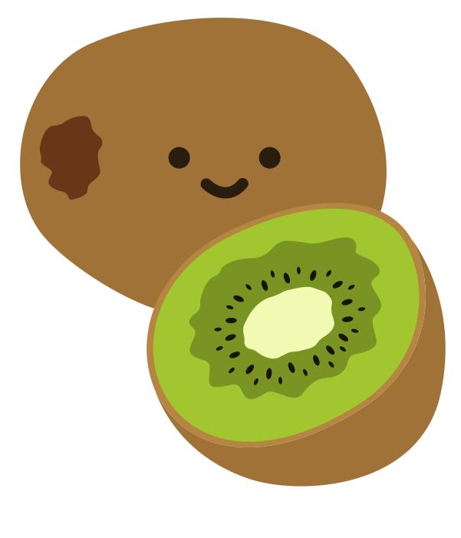
do you like fruits?
Yes, I do
No, I don’t

Slide 6
Orange
Strawberry
Watermelon
Kiwi
Banana
Cherries

Slide 7



do you like junk food?
Yes, I do
No, I don’t

Slide 8
Fries
Candy
Hotdog
Ice cream
Donut
Pizza

Slide 9
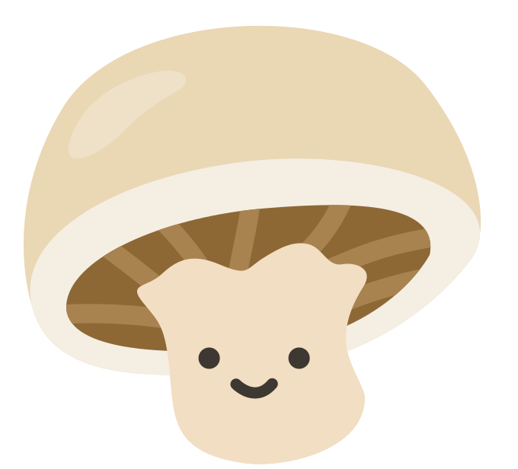
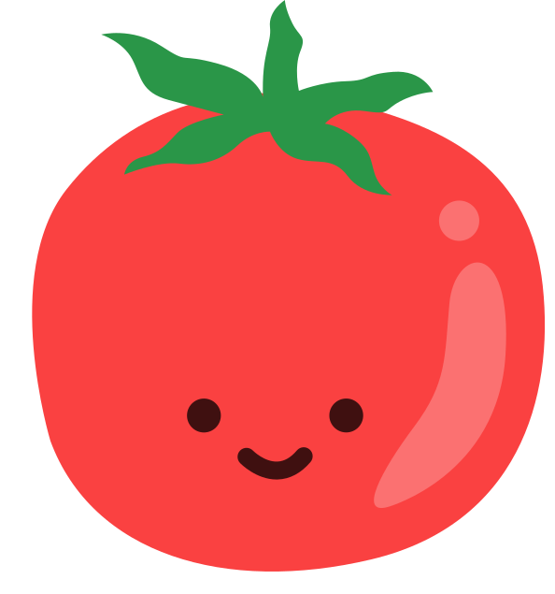
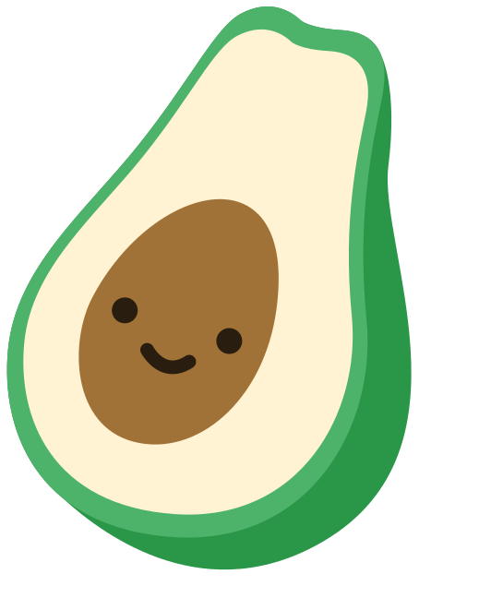
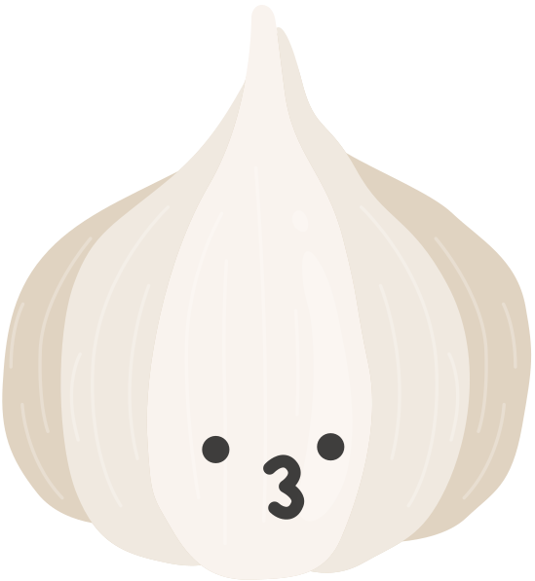
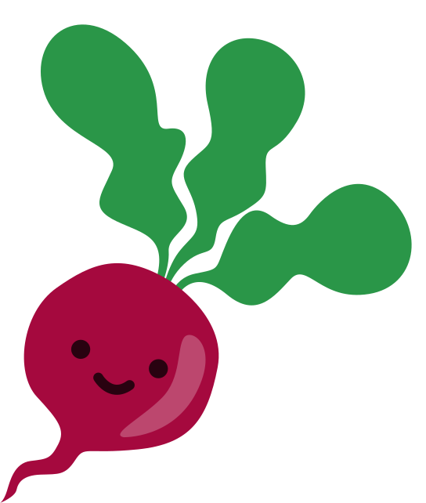
do you like vegetables?
Yes, I do
No, I don’t

Slide 10
Tomato
Onion
Carrot
Garlic
Avocado
Pepper
Radish
Mushroom

Slide 11
what do you like?

Slide 12
Look at the images and tell the class if you like it or you don’t like it
Do you like carrots?
Do you like donuts?
Do you like oranges?

Slide 13
teacher resources
b
For blur
Fonts
d
For drumroll
Titles
q
For quiet
Body
x
To close
For confetti
Color palette
c
o
For bubbles
u
For unveil
Any number from 0-9 for timer

